Slide 1
Design and Analysis of Experiments
Douglas C. Montgomery
Regents’ Professor of Industrial Engineering and Statistics
ASU Foundation Professor of Engineering
Arizona State University
Chapter 1
Design & Analysis of Experiments 8E 2012 Montgomery
Notes:
This is a basic course blah, blah, blah…

Slide 2
Design of Engineering Experiments
Part 1 – Introduction
Chapter 1, Text
Why is this trip necessary? Goals of the course
An abbreviated history of DOX
Some basic principles and terminology
The strategy of experimentation
Guidelines for planning, conducting and analyzing experiments
Chapter 1
Design & Analysis of Experiments 8E 2012 Montgomery

Slide 3
Introduction to DOX
An experiment is a test or a series of tests
Experiments are used widely in the engineering world
  Process characterization & optimization
  Evaluation of material properties
  Product design & development
  Component & system tolerance determination
“All experiments are designed experiments, some are poorly designed, some are well-designed”
Chapter 1
Design & Analysis of Experiments 8E 2012 Montgomery

Slide 4
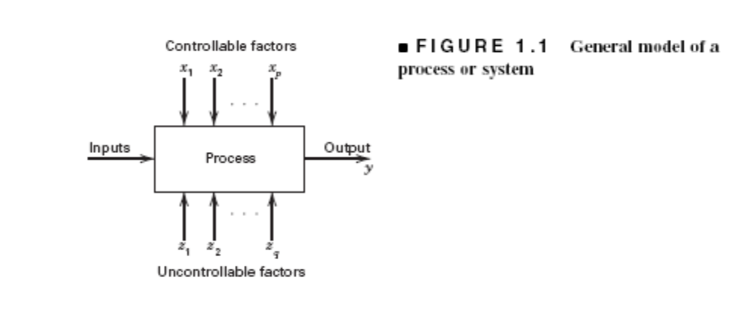

Engineering Experiments
Reduce time to design/develop new products & processes
Improve performance of existing processes
Improve reliability and performance of products
Achieve product & process robustness
Evaluation of materials, design alternatives, setting component & system tolerances, etc.
Chapter 1
Design & Analysis of Experiments 8E 2012 Montgomery

Slide 5
Four Eras in the History of DOX
The agricultural origins, 1908 – 1940s
  W.S. Gossett and the t-test (1908)
  R. A. Fisher & his co-workers
  Profound impact on agricultural science
  Factorial designs, ANOVA
The first industrial era, 1951 – late 1970s
  Box & Wilson, response surfaces
  Applications in the chemical & process industries
The second industrial era, late 1970s – 1990
  Quality improvement initiatives in many companies
  Taguchi and robust parameter design, process robustness
The modern era, beginning circa 1990
Chapter 1
Design & Analysis of Experiments 8E 2012 Montgomery

Slide 6
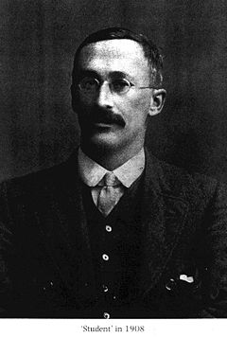
William Sealy Gosset (1876-1937)
Gosset's interest in barley cultivation led him to speculate that design of experiments should aim, not only at improving the average yield, but also at breeding varieties whose yield was insensitive (robust) to variation in soil and climate.
Gosset was a friend of both Karl Pearson and R.A. Fisher, an achievement, for each had a monumental ego and a loathing for the other.
Gosset was a modest man who cut short an admirer with the comment that “Fisher would have discovered it all anyway.”
Chapter 1
Design & Analysis of Experiments 8E 2012 Montgomery

Slide 7
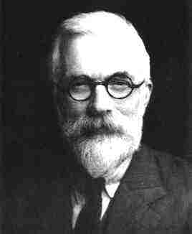
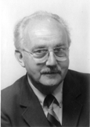
R. A. Fisher (1890 – 1962)
George E. P. Box
Chapter 1
Design & Analysis of Experiments 8E 2012 Montgomery

Slide 8
The Basic Principles of DOX
Randomization
  Running the trials in an experiment in random order
  Notion of balancing out effects of “lurking” variables
Replication
  Sample size (improving precision of effect estimation, estimation of error or background noise)
  Replication versus repeat measurements? (see pages 12, 13)
Blocking
  Dealing with nuisance factors
Chapter 1
Design & Analysis of Experiments 8E 2012 Montgomery

Slide 9
Strategy of Experimentation
“Best-guess” experiments
  Used a lot
  More successful than you might suspect, but there are disadvantages…
One-factor-at-a-time (OFAT) experiments
  Sometimes associated with the “scientific” or “engineering” method
  Devastated by interaction, also very inefficient
Statistically designed experiments
  Based on Fisher’s factorial concept
Chapter 1
Design & Analysis of Experiments 8E 2012 Montgomery

Slide 10
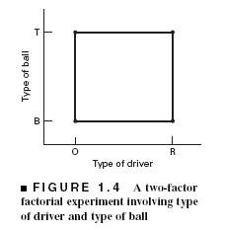
Factorial Designs
In a factorial experiment, all possible combinations of factor levels are tested
The golf experiment:
  Type of driver
  Type of ball
  Walking vs. riding
  Type of beverage
  Time of round
  Weather
  Type of golf spike
  Etc, etc, etc…
Chapter 1
Design & Analysis of Experiments 8E 2012 Montgomery

Slide 11
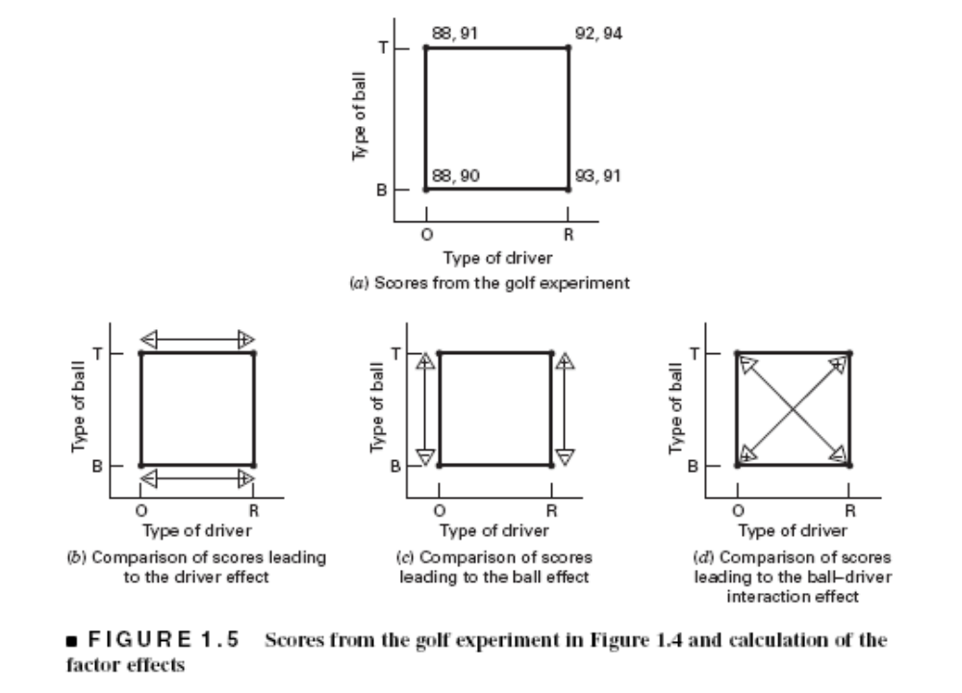
Factorial Design
Chapter 1
Design & Analysis of Experiments 8E 2012 Montgomery

Slide 12
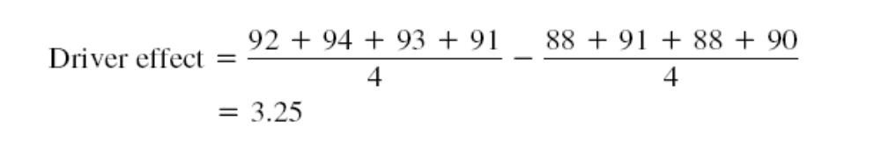
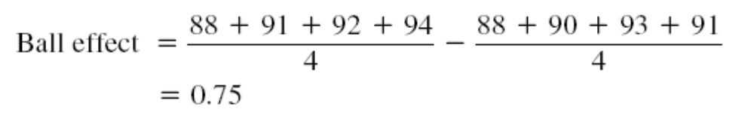

Chapter 1
Design & Analysis of Experiments 8E 2012 Montgomery

Slide 13
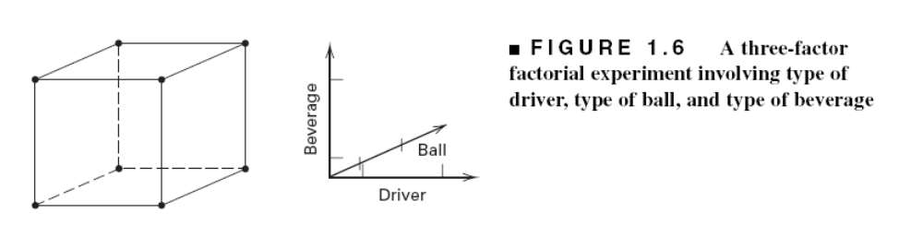
Factorial Designs with Several Factors
Chapter 1
Design & Analysis of Experiments 8E 2012 Montgomery

Slide 14
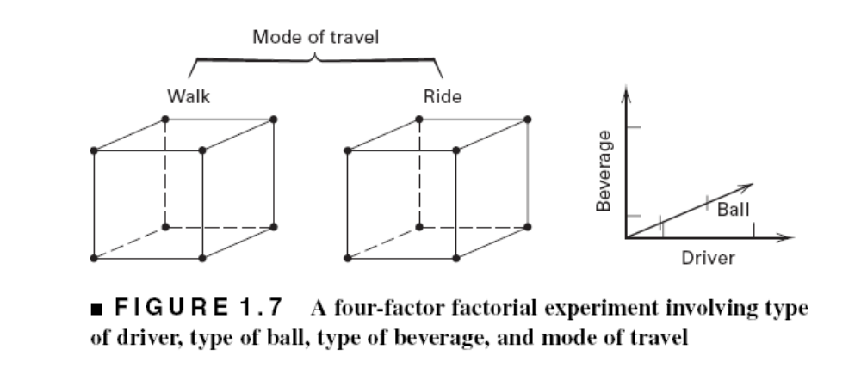
Chapter 1
Design & Analysis of Experiments 8E 2012 Montgomery

Slide 15
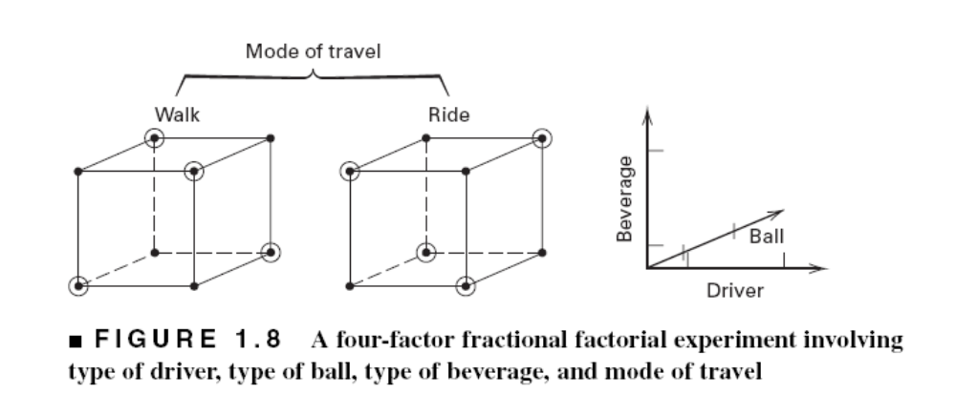
Factorial Designs with Several Factors
A Fractional Factorial
Chapter 1
Design & Analysis of Experiments 8E 2012 Montgomery

Slide 16
Planning, Conducting & Analyzing an Experiment
Recognition of & statement of problem
Choice of factors, levels, and ranges
Selection of the response variable(s)
Choice of design
Conducting the experiment
Statistical analysis
Drawing conclusions, recommendations
Chapter 1
Design & Analysis of Experiments 8E 2012 Montgomery

Slide 17
Planning, Conducting & Analyzing an Experiment
Get statistical thinking involved early
Your non-statistical knowledge is crucial to success
Pre-experimental planning (steps 1-3) vital
Think and experiment sequentially (use the KISS principle)
See Coleman & Montgomery (1993) Technometrics paper + supplemental text material
Chapter 1
Design & Analysis of Experiments 8E 2012 Montgomery

